Slide 1
Online Product sales like Amazon

Slide 2
Introduction
This project focuses on a Smart Device application that includes, Product Search: Allows users to efficiently search and filter through a wide range of smart devices based on their preferences .
Product Details: Provides comprehensive information on each smart device, including specifications, features, and images to help users make informed decisions . Payment Gateway: Integrates a secure payment gateway for seamless and safe transactions, enhancing user convenience and trust.

Slide 3
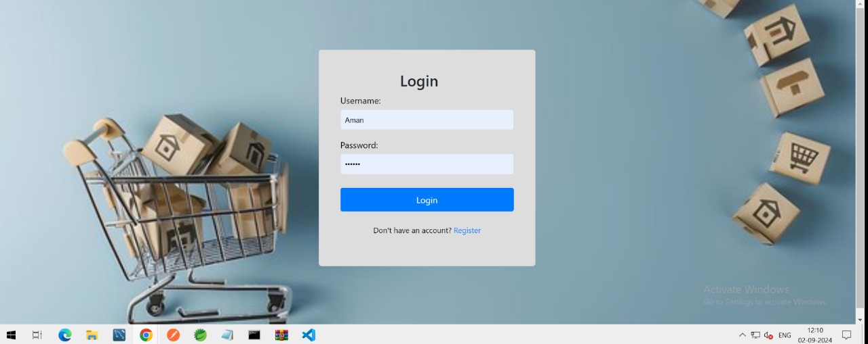
Login Page
Secure Authentication: The login functionality ensures secure access to the application by requiring users to authenticate with a unique username and password. This helps protect user data and restrict access to authorized users only.
User Validation: During login, the system validates the entered credentials against stored user information in the database, ensuring that only valid and registered users can access the system. This process helps maintain the integrity and security of the application.

Slide 4
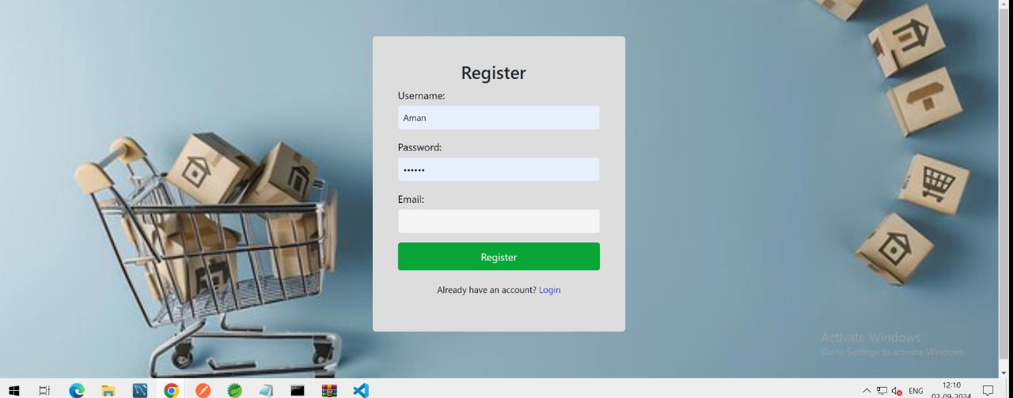
Registration Page
Username: "Choose a unique username that represents you within our community. This will be your identity across the platform.
Password: "Create a strong password to protect your account. Use a mix of letters, numbers, and special characters to ensure security.“
Email: "Enter a valid email address. We’ll use this for account verification and important communications."

Slide 5
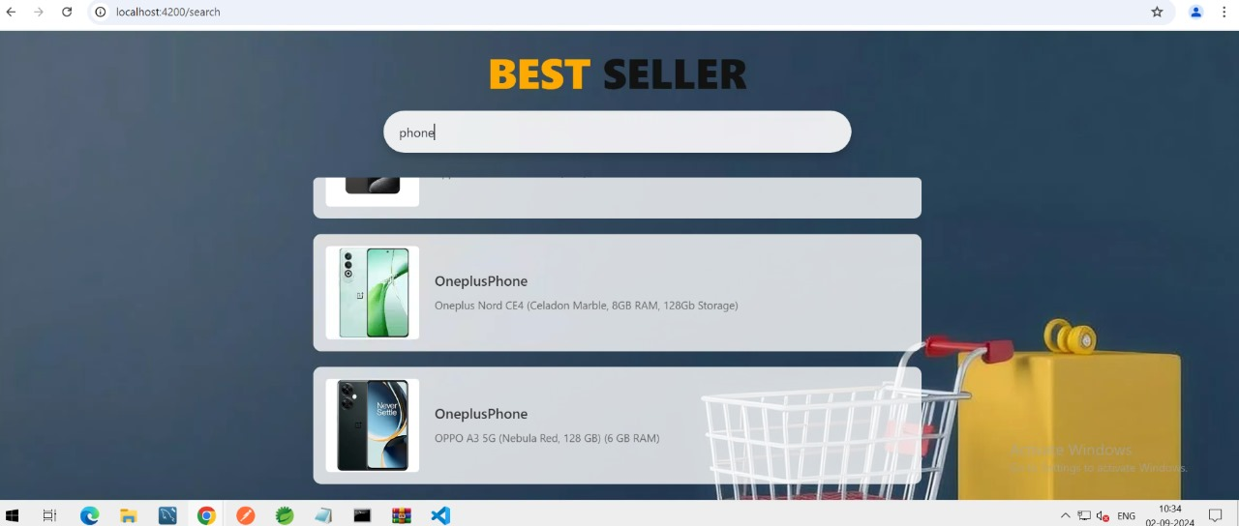
Home Page
Users can be able to search the products, based on their search users can see the list of products

Slide 6
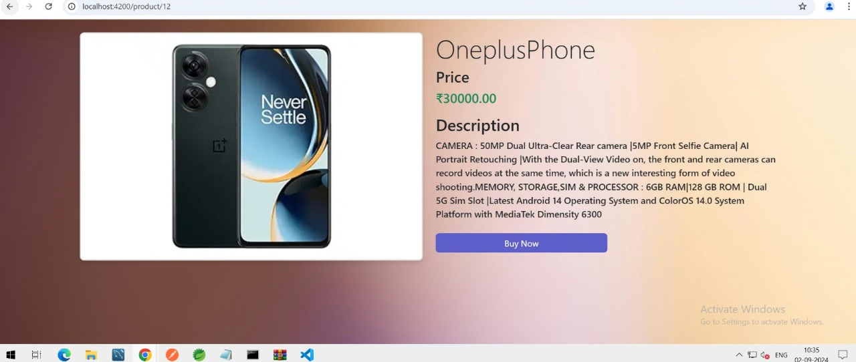
Product Details Page
The product details page provides a detailed description of each product, including its features, specifications, and other relevant information. This comprehensive overview helps users make informed purchasing decisions by giving them a clear understanding of what the product offers.

Slide 7
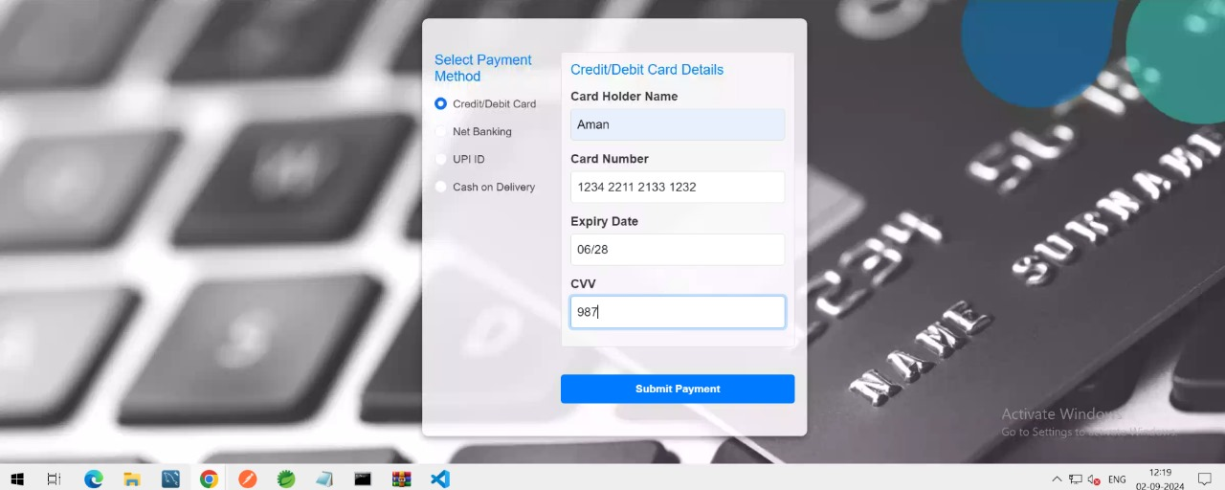
Payment details page
Credit/Debit Card: "Securely enter your credit or debit card details. “
Net Banking: “Give your bank credentials for the payment“
UPI: "Use UPI for instant payments. Simply enter your UPI ID, and authorize the payment from your preferred UPI app.“
Cash on Delivery: "Choose Cash on Delivery ,it will not require any details for ordering the product."

Slide 8
Team members
Asmit Patel
Dipti Rai
Ankit Ithape
Deepak verma
Ashish Kumar Giri
Geetha Madhuri
Anuj Verma

Slide 9
Thank you

